Slide 1

Community Blood Pressure A community group learning together in Peckham
Ernest Nkrumah - The Ernest Foundation
Delivered in partnership with The Lister Primary Care Centre

Slide 2
Preparing for the event
1) Purpose of event clear – health promotion, networking, wellbeing
2) Consult with Lister practice about patient needs = BP+ diabetes, vaccinations, cancer awareness
3) Brief volunteers and staff –all clear roles
Logistics
1) Peckham Square - accessibility
2) Partnered with Foodbank
3) Collection of materials needed
4) Balanced schedule of screenings, workshops, community building
5) Ensures safe-guarding and risk assessment
Promotion and outreach
1) Social media, flyers, community word of mouth
2) Partners Elim House, Southwark Counsil, Southwark Health Ambassadors helped distribute invites and mobilise local attendance
3) Direct referrals from health partners
Notes:
A lot of prep and coordination

Slide 3
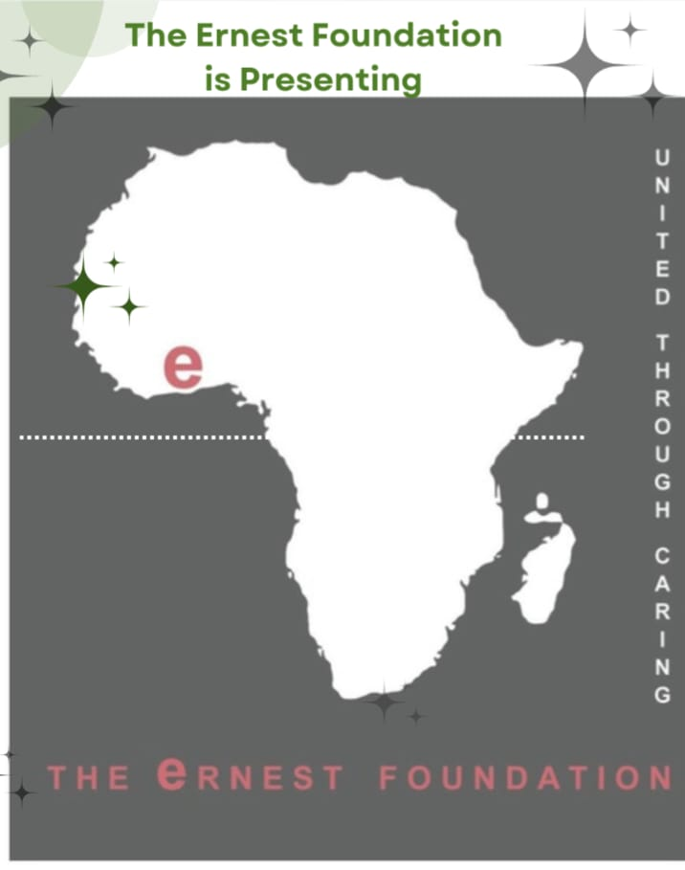
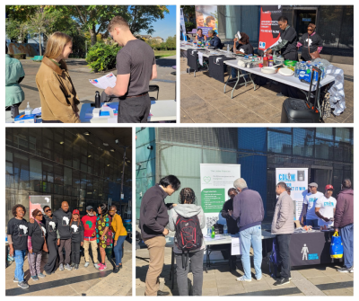
Delivery and Follow-up
On the day, nurses/doctors managed registration, data collection, and participant support.
Health professionals conducted screenings and gave tailored advice.
Activities were interactive and engaging, building trust and encouraging ongoing participation.
Some numbers
>250 people attended, 142 residents received a BP check, 21 were referred to their GP of which 2 had severely high readings

Slide 4
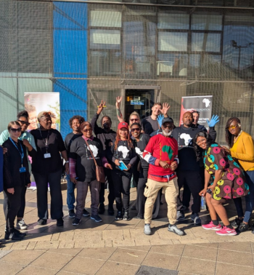
What went well?
1) Attendance >250 people
2) Not just BP – also cancer, vaccinations, diabetes
3) Partnership working – CGL, Cancer awareness, Mental Health, Social Prescribing, Foodbank
Next time, what to change?
1) More promotion
2) Documentation
3) Flow and structure of the event
What people loved?
1) Inclusive access
2) Volunteer support
3) Community spirit!
4) Positive feedback – residents valued the free health check, interactive sessions and being informed about general wellbeing
Notes:
A lot of prep and coordination

Slide 5
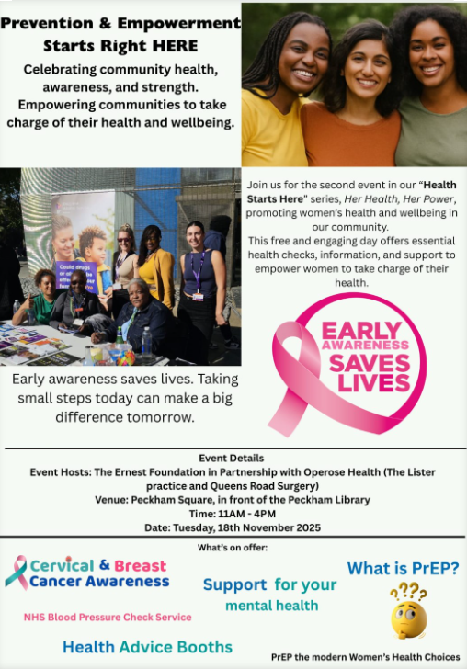

Slide 6
The Ernest Foundation
The Ernest Foundation, which led the Peckham event, is a charity dedicated to promoting a healthy and resilient community. Their Health in Harmony programme is a community-based initiative that supports the physical, mental, and economic well-being of disadvantaged and marginalised residents across Southwark and neighbouring boroughs.Ernest
“Simple community events offering free blood pressure checks can make a powerful difference, helping people take control of their health early, prevent complications, and build a healthier community together.” – The Ernest Foundation

